Slide 1


Title of Project
Prepared By: (Name)
Regd. NO: 132142454435, ROLL No: R8342655434354
Course Code : 34254
Current mobile: +91 321465432
Email: lpu@gmail.com
Research Gate: (ANY OTHER LINK )
Submitted To: (Supervisor Name)
Dept: (Dept)
University: Lovely Professional University Jalandhar Punjab India

Slide 2
Content of Presentation
1. Introduction & Research Foundation
2. Advanced Methodology & Optimization
3. Comprehensive Results & Validation
4. System Integration & Deployment
5. Research Output & Intellectual Property/
6. Critical Discussion & Challenges
7. Conclusion & Future Directions
8. References & Appendices
9 Research Paper Status Of Submission
10 Status of Thesis Report

Slide 3
1. Introduction & Research Foundation
  1.1 Project Synthesis: Final summary of the problem, objectives, and high-level solution.
  1.2 Literature Synthesis: Brief recap of the core papers that influenced the final architecture.
  1.3 Research Gap Addressed: The specific contribution this project makes to the field (e.g., improved accuracy, real-time processing, or novel feature set).
2. Advanced Methodology & Optimization
  2.1 Proposed Research Framework: Detailed flow of the final, optimized system.
  2.2 Final Algorithm & Mathematical Modeling: Finalized formulas, loss functions, or logic used in the production-ready model.
  2.3 Hyperparameter Optimization: Results from tuning (GridSearch/Optuna) to reach peak performance.
3. Comprehensive Results & Validation
  3.1 Performance Evaluation: Final metrics (Accuracy, F1-Score, ROC-AUC, RMSE) with graphical representations.
  3.2 Statistical Significance: Any tests (like T-tests or ANOVA) to prove the model's reliability.
  3.3 Ablation Study: Analysis of how individual components (e.g., specific features or layers) contributed to the final result.
4. System Integration & Deployment
  4.1 Final UI/UX Implementation: Screenshots and logic of the functional application (e.g., Python Tkinter or Web App).
  4.2 Deployment Pipeline: How the model is served (API, Pickle, or Cloud) and its real-world latency.
5. Research Output & Intellectual Property
  5.1 Research Paper Manuscript: * Drafting Status: Title, Abstract, and Keywords.
    Target Journal/Conference: Potential venues for submission (e.g., IEEE, Springer, or Scopus-indexed journals).
  5.2 Patent / Intellectual Property (IP) Considerations:
    Novelty Assessment: What part of the logic or system is unique enough for a patent/copyright.
    Patent Filing Status: Description of the "Patient of Work" (Current stage of filing or documentation for a provisional patent).
    Software Copyright: Details on protecting the source code or unique GUI design.
6. Critical Discussion & Challenges
  6.1 Technical Hurdles Overcome: Final reflection on the toughest bugs or data issues resolved in Phase 3.
  6.2 Limitations & Constraints: Honest assessment of the system’s boundaries.
7. Conclusion & Future Directions
  7.1 Final Summary: Impact of the work on the target domain.
  7.2 Scalability & Future Scope: How this research can be expanded (e.g., Multi-modal integration or larger datasets).
8. References & Appendices
  8.1 Final Bibliography: Using standard citation styles (APA/IEEE).
  8.2 Plagiarism/Similarity Report: Evidence of original research writing.

Slide 4
Introduction (Font Size need to follow)
To build computational skills through hands-on and practice-based learning with measurable outcomes.
To establish a strong connect with industry for in-demand technology driven curriculum.
To build the infrastructure for meaningful research around societal problems.
To nurture future leaders through research-infused education and lifelong learning.
To create smart and ethical professionals and entrepreneurs who are recognized globally.

Slide 6
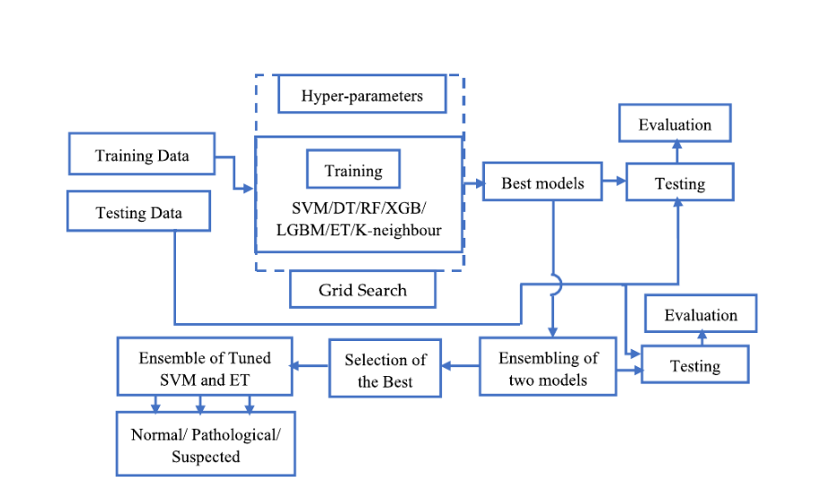
Final Proposed System

Slide 8
5.1 Pest mail screen shot of last communication about research paper

Slide 12
References(APA)
A. Research Papers (Journals/Conferences)
  Format: [Ref No.] Author(s), "Title of Paper," Title of Journal/Conference, Vol., No., pp. Page numbers, Month, Year.
  Example: [1] A. Sharma and R. Goel, "A Comparative Analysis of Machine Learning Algorithms for Predictive Analytics," International Journal of Computer Applications, Vol. 178, No. 12, pp. 22-29, Oct. 2025.
B. Books
  Format: [Ref No.] Author(s), Title of the Book, Edition (if any). City, State/Country: Publisher, Year.
  Example: [2] T. Cormen, C. Leiserson, and R. Rivest, Introduction to Algorithms, 3rd ed. Cambridge, MA, USA: MIT Press, 2009.
C. Websites / Online Documentation
  Format: [Ref No.] Author/Organization, "Title of Page," Year. [Online]. Available: URL. [Accessed: Date].
  Example: [3] Scikit-Learn Developers, "Supervised Learning - Comparison of Algorithms," 2024. [Online]. Available: https://scikit-learn.org/stable/supervised_learning.html. [Accessed: Jan. 15, 2026].

Slide 13
Addition Research work Done
01. “BOOK CHAPTER TITLE” , where “BOOK NAME” and the publisher's “NAME”.
02. “CONFERENCE PAPER”, Where “Conference NAME” and “Other Details. ”
03. ……..
04. ………

Slide 14
Research Paper status

